Slide 1
MINI PROJECT Data Manipulation and Management using MYSQL Workbench Exploring and Analyzing FIFA's Datasets using Python Building Statistical Models in R:Linear Regression
Sampada D D
22254090002

Slide 2
Data Manipulation and Management using MYSQL Workbench ->MySQL Workbench is a unified visual tool for database architects, developers, and DBAs ->MySQL Workbench provides data modeling, SQL development, and comprehensive administration tools for server configuration, user administration, backup, and much more. ->MySQL Workbench is available on Windows, Linux and Mac OS X. ->MySQL is a widely used relational database management system (RDBMS). ->MySQL is free and open-source. ->MySQL is ideal for both small and large applications.

Slide 3
RDBMS stands for Relational Database Management System. ->RDBMS is a program used to maintain a relational database. ->RDBMS is the basis for all modern database systems such as MySQL, Microsoft SQL Server, Oracle, and Microsoft Access. ->A table is a collection of related data entries, and it consists of columns and rows. ->A column holds specific information about every record in the table. ->A record (or row) is each individual entry that exists in a table. ->A relational database defines database relationships in the form of tables. The tables are related to each other - based on data common to each.

Slide 4
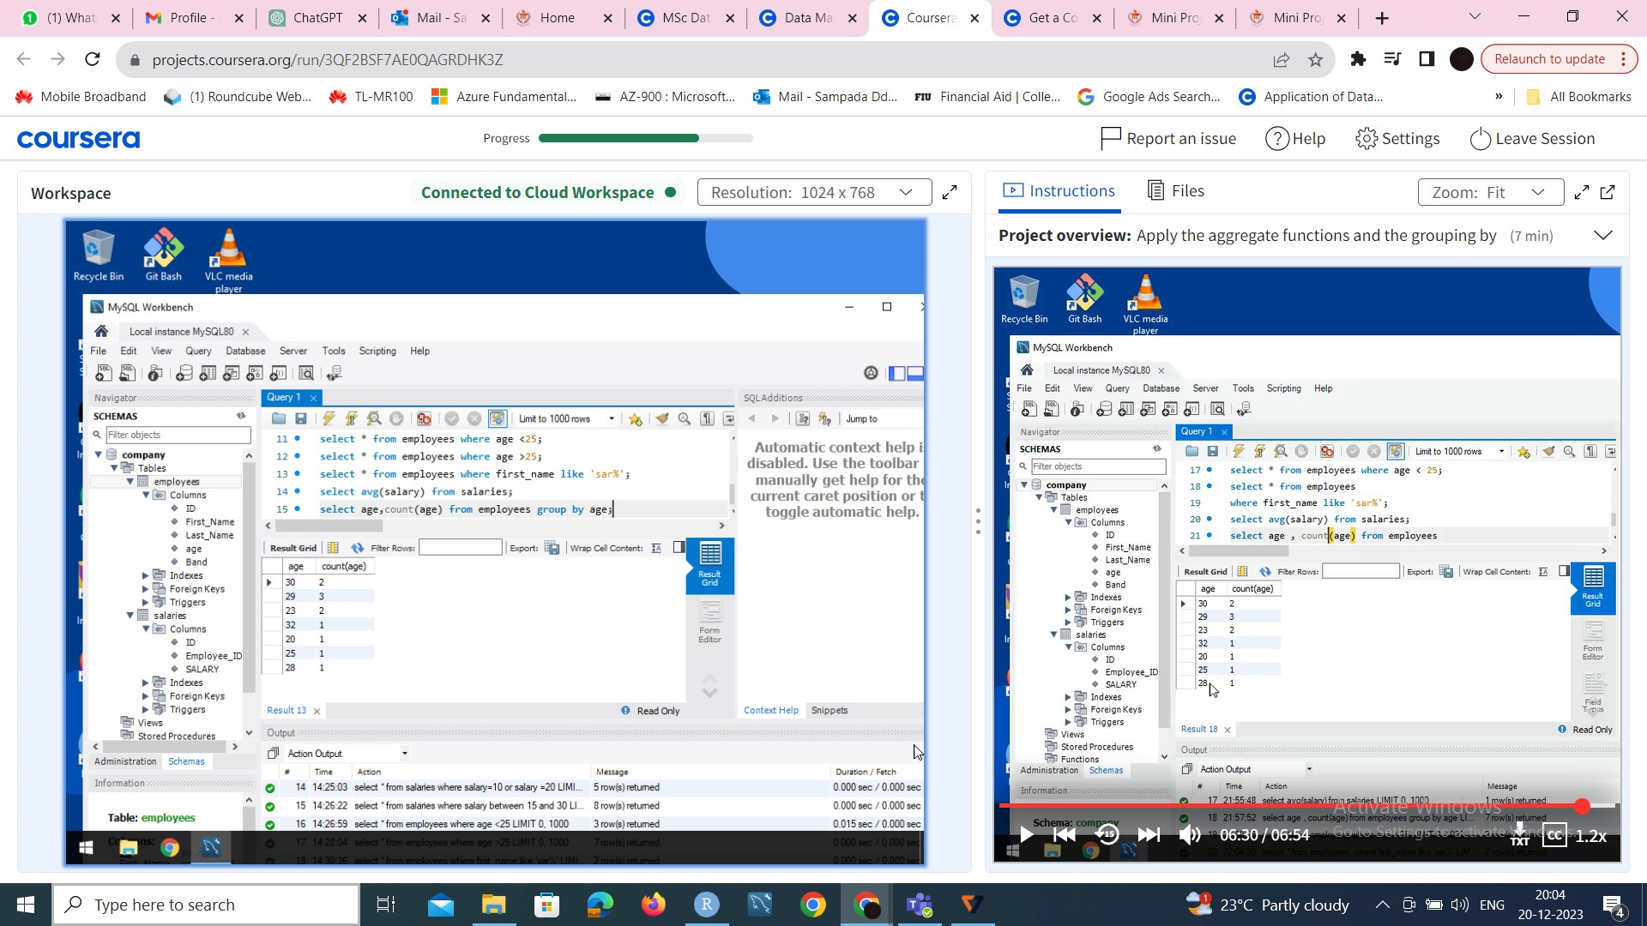
1)Data Manipulation and Management using MYSQL Workbench
Selecting data with several features and keywords
Select * from employees where age<25

Slide 5
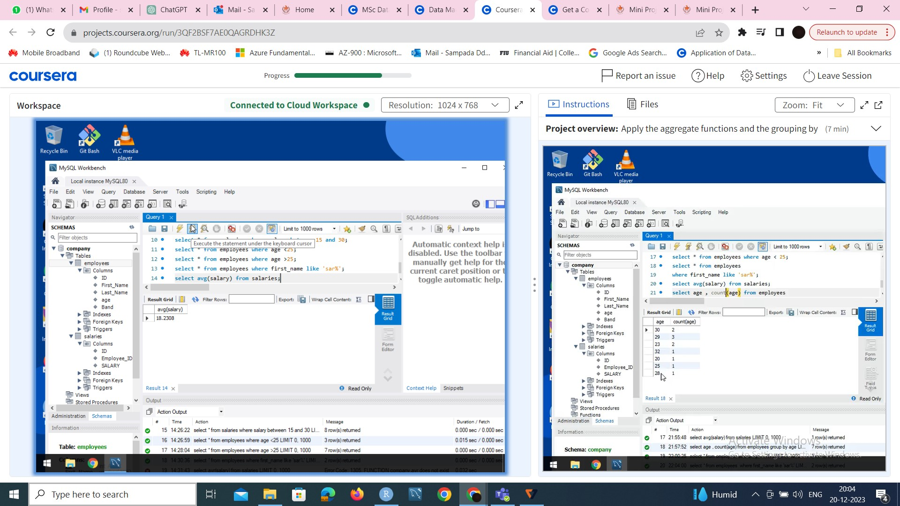
Apply aggregate functions and Grouping By -> Select avg(salary) from salaries group by id There are many aggregate functions in MySql like SUM,COUNT,MIN,MAX,FIRST

Slide 6
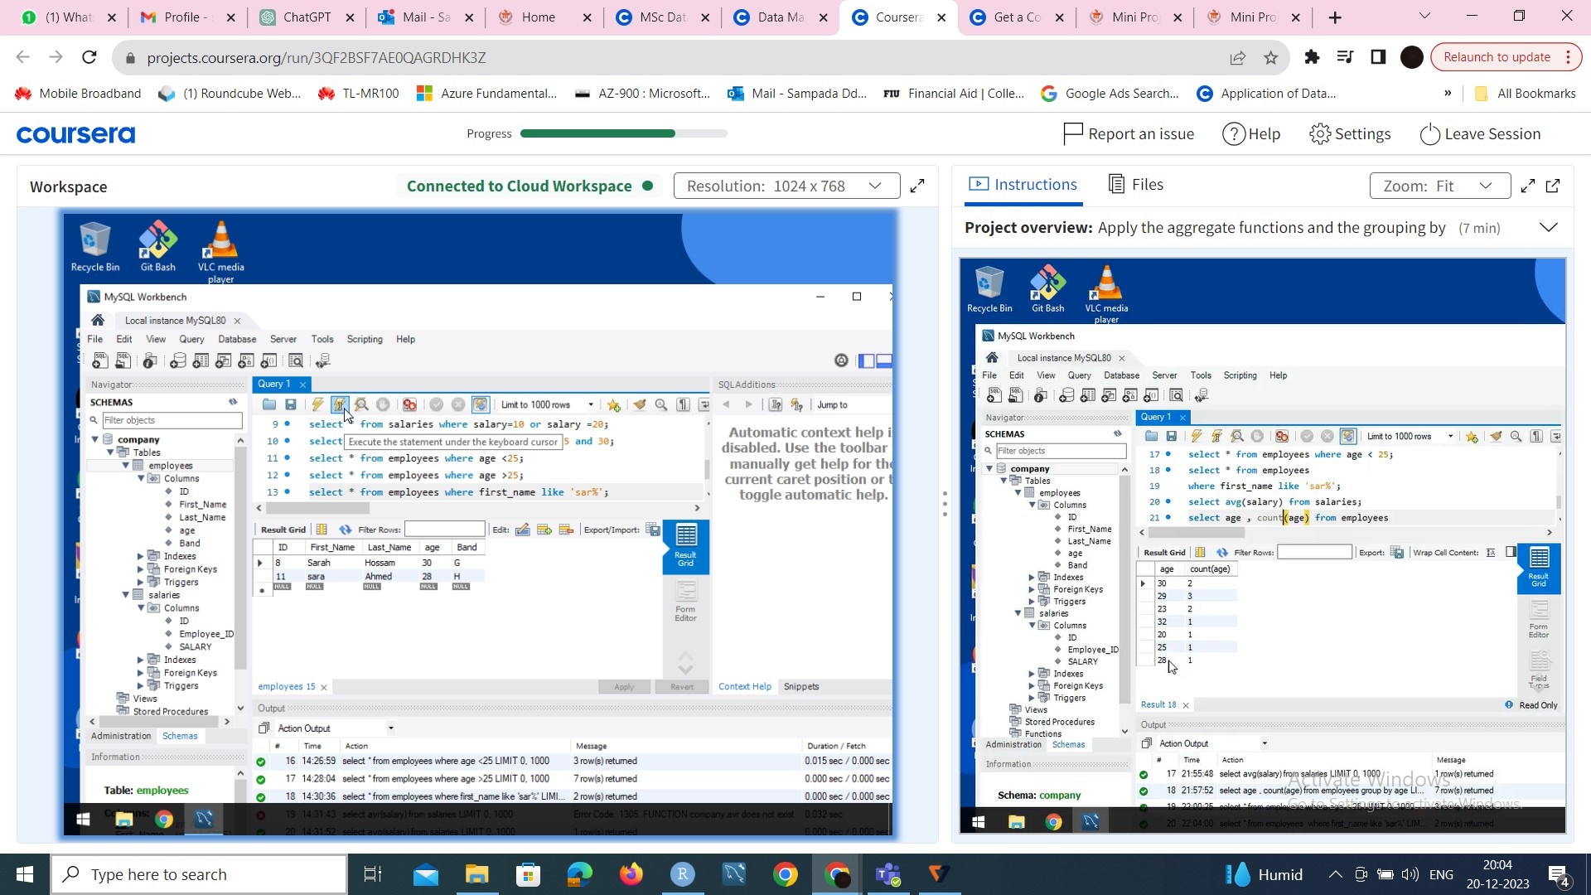
Filter data using different conditions -> We can filter data from the table to get desired values on specific conditions using where and order by clause

Slide 7
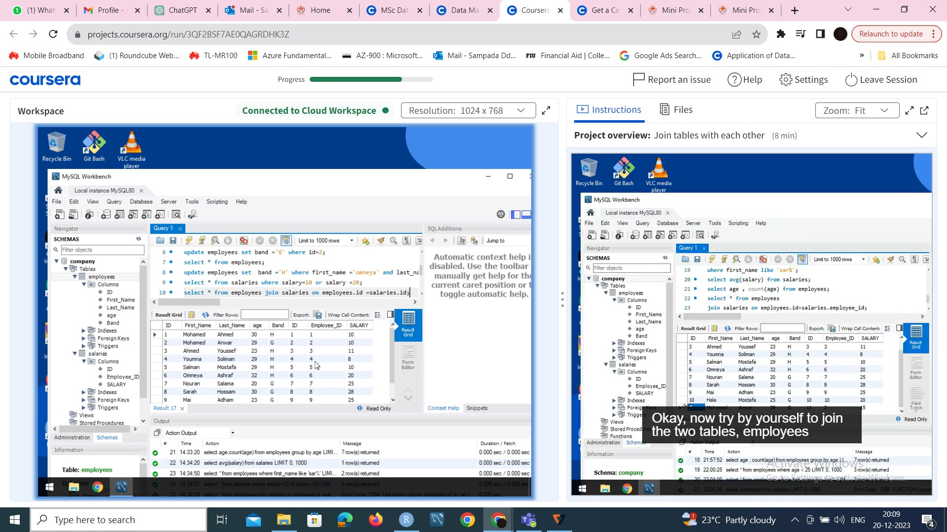
Join Tables -> A JOIN clause is used to combine rows from two or more tables , based on a relation between them

Slide 8
Exploring and Analyzing FIFA's Data Sets Using Python -> Task 1: Load data-The process of importing or ingesting data from various sources into a data pipeline or data storage system such as data warehouse -> Task 2:Tidy data –A standard way of mapping the meaning of a dataset to its structure -> Task 3: Visualize data- Graphical representation of data and information -> Task 4: Feature engineering –Process of selecting , manipulation and transforming raw data -> Task 5: Merge the datasets -The process of combining 2 or more records into a single one -> Task 6: Create a radar plot-A graphical method used to exhibit multivariate data on a two dimensional chart consisting of 3 or more quantitative variable

Slide 9
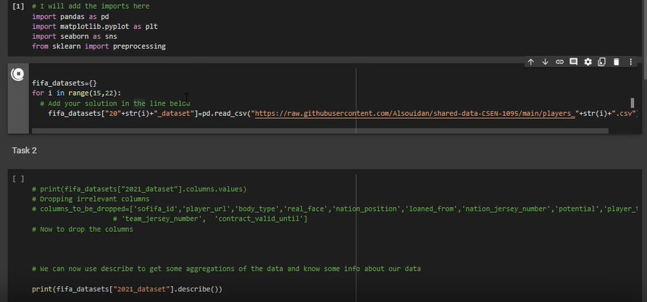
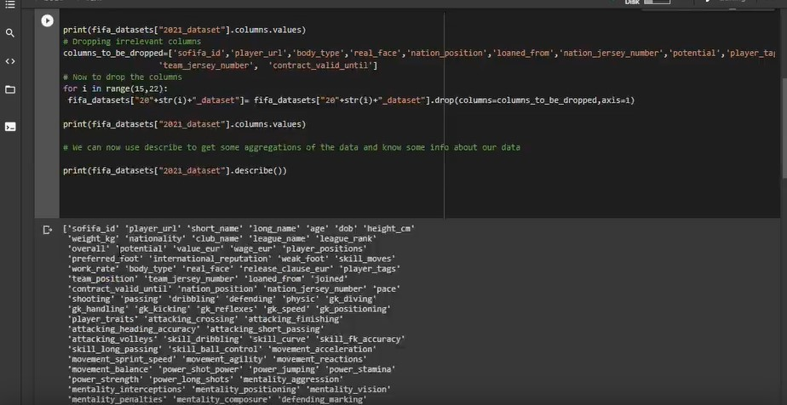
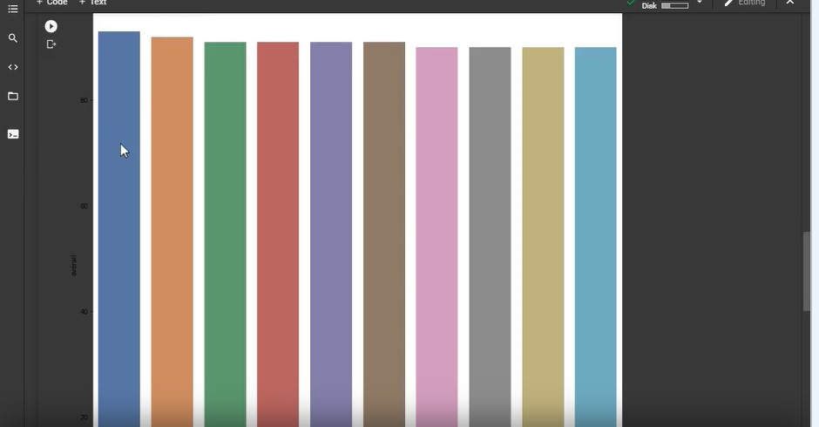
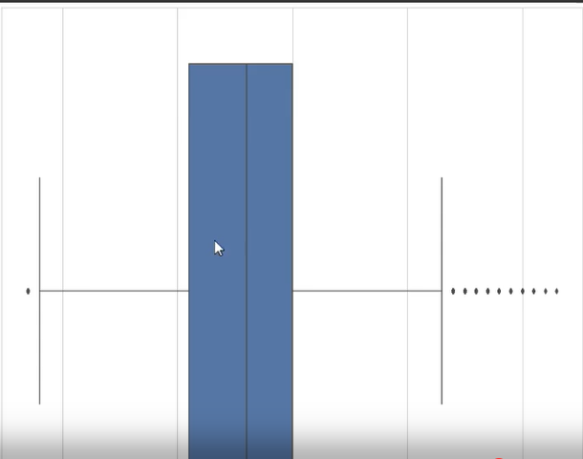
2)Exploring and Analyzing FIFA's Datasets using Python

Slide 10
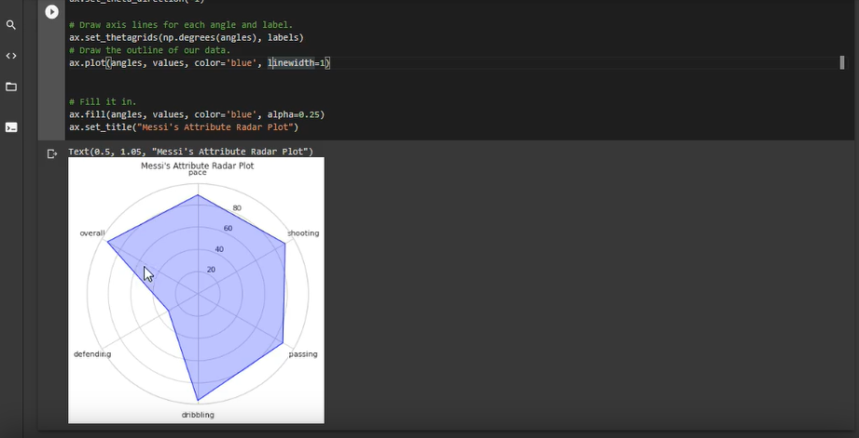
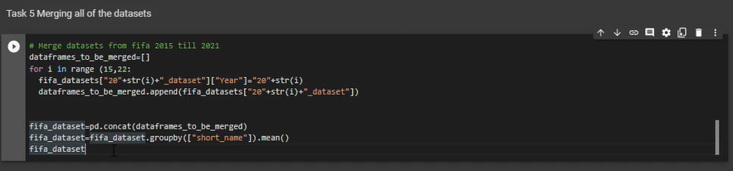
.

Slide 11
Building Statistical Models in R: Task 1: Getting Started Statistical modeling concepts Linear Regression concepts A brief introduction to the Rhyme platform Change the panes and font size Set and get the working directory Task 2: Import Packages & the dataset Importing required packages Import the mpg.csv dataset View and check the dimension of the dataset Task 3: Explore the dataset Take a peek using the head and tail functions Check the internal structure of the data frame Count missing values in the variables Check the column names for the data frame Drop the first column of the data frame Task 4: Data Visualization Plot a scatter plot for the variables with cty on the x-axis hwy on the y-axis Find the correlation between the variables Task 5: Model Building Create a simple linear regression model using the variables Plot the regression line for the model

Slide 12
Task 6: Model Assessment I Assess the summary of the fitted model Calculate the confidence interval for the coefficients Task 7: Model Assessment II Assess the summary of the fitted model Calculate the prediction error of the fitted model Task 8: Model Prediction Find the fitted values of the simple regression model Visualize the residuals of the fitted model Predict new values using the model Task 9: Assumptions Check: Diagnostic Plots Plotting the fitted model Return the first diagnostic plot for the model Return the second diagnostic plot for the model Return the third diagnostic plot for the model Task 10: Multiple Regression Build the multiple regression model with hwy as the y-variable and cty and cyl as the x-variable Check the summary of the multiple regression model Plot the fitted multiple regression model

Slide 13
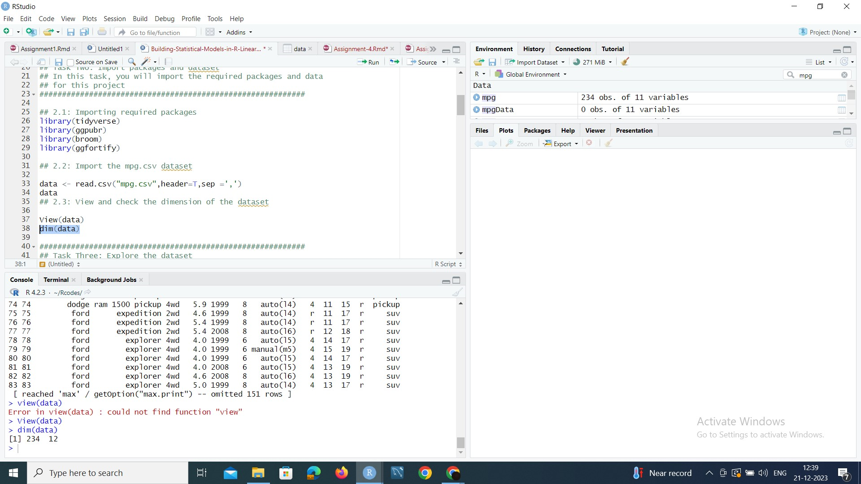
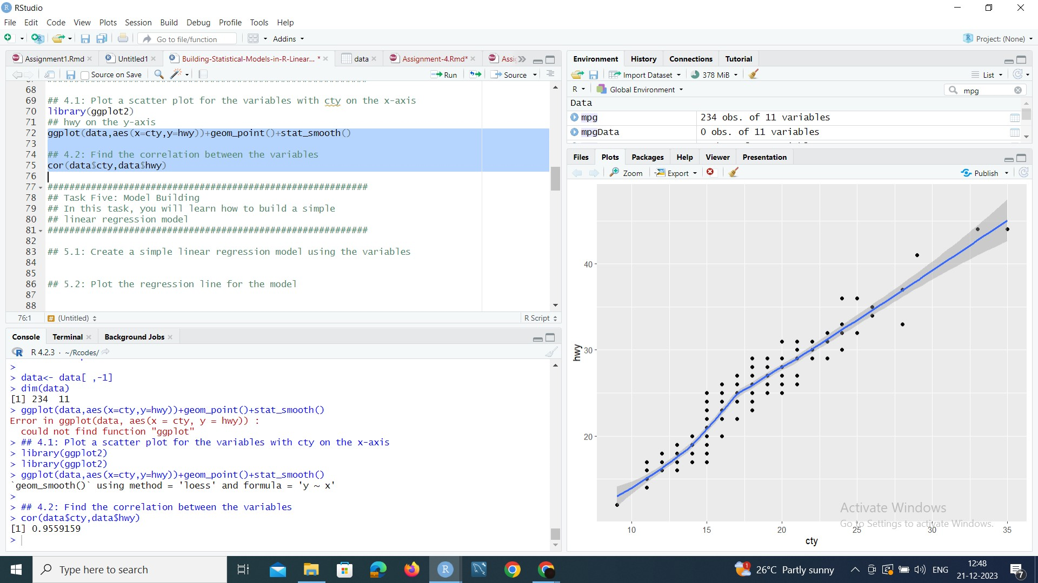
3)Building Statistical Models in R: ->Importing the library and packages into the R tool -> Plot a scatter plot to identify the relationship of the values of a column : i.e linearity of the values

Slide 14
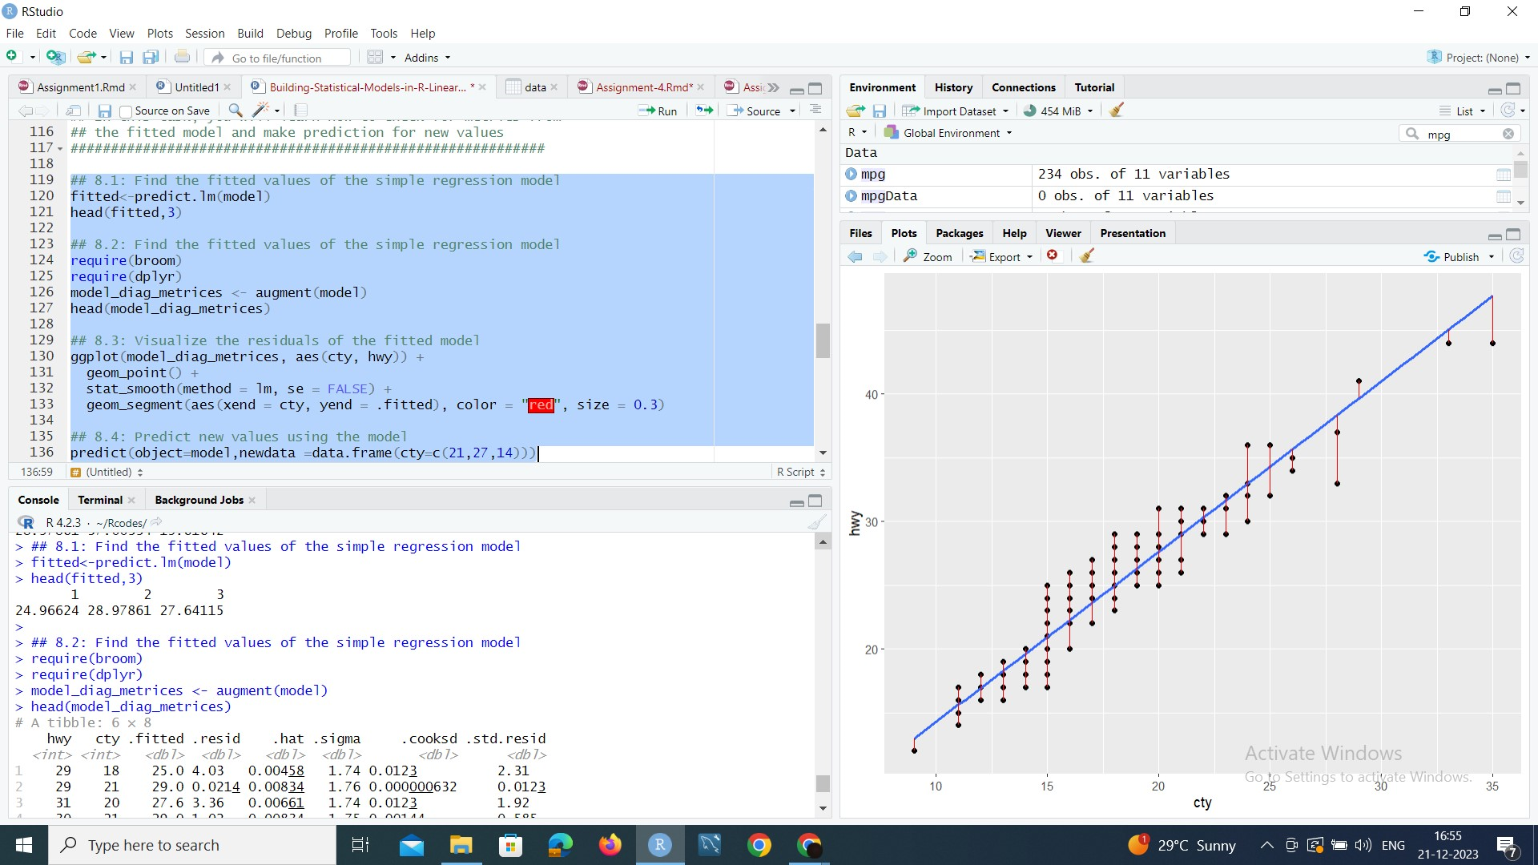
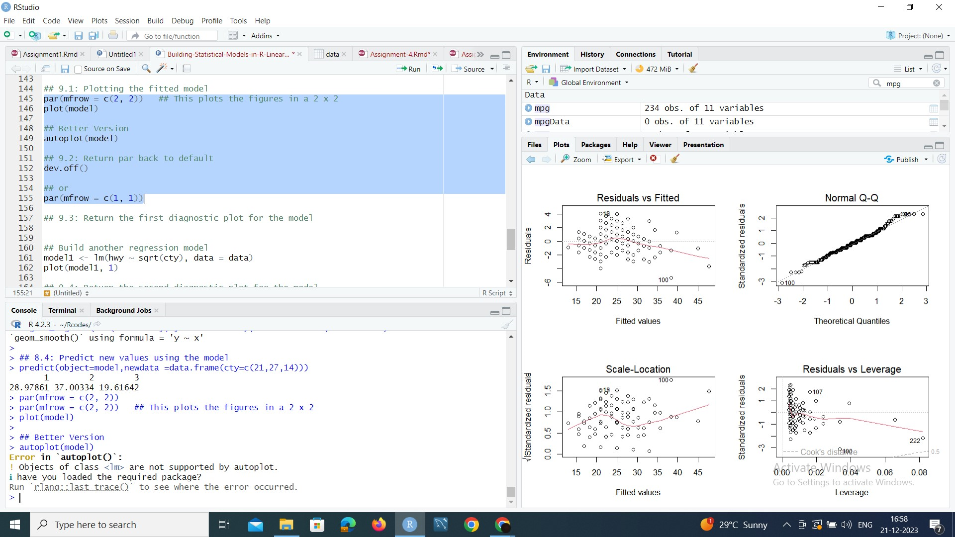
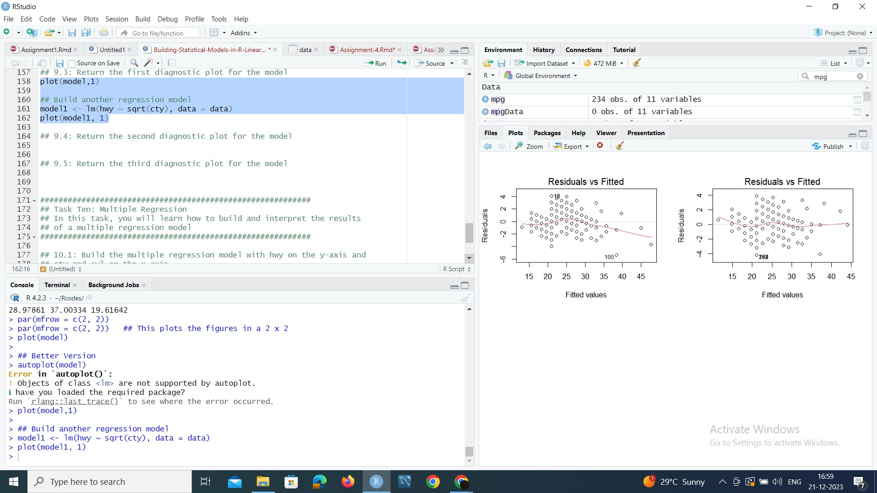
->Plot the regression linear model using the variables and assessing the summary of the fitted model ->Creating diagnostic plots for the model ,comparing and understanding the plots ->Finally creating a multiple regression plot

Slide 15
Skills gained and their application in real life problems 1)SQL -> Web Development Businesses use SQL to retrieve specific data from databases for reporting and analysis purposes. ->Customer Relationship Management System CRM systems use SQL to store and retrieve customer data, track interactions and manage relationships with clients. ->Healthcare Systems Electronic health record systems utilize SQL to store and retrieve patient information , medical histories and treatment records.

Slide 16
2) Python ->Automation and Scripting Python is widely used for scripting and automation tasks due to its simplicity and readability ->Game Development Python, with libraries like Pygame, is used in game development for prototyping , scripting and developing smaller–scale games. ->Education Python is a popular language for teaching programming due to its readability and simplicity

Slide 17
3) R programming ->Bioinformatics: R is widely used in bioinformatics for the analysis of genomics and proteomics data. ->Geospatial Analysis: R is used for geospatial analysis, including mapping, spatial statistics and visualization of geographical data ->Government and Public Policy: R is used by government agencies for analyzing public policy data, conducting economic analyses and making data-driven decisions

Slide 18
Tools used and their applications at workplace to derive data driven decisions

Slide 19
MySQL Workbench: 1. Data Modeling: Use MySQL Workbench to design and model your database schema visually. This helps in understanding the structure of your data and ensures that it aligns with business requirements. 2. Database Administration: Perform routine database administration tasks using MySQL Workbench. This includes tasks such as user management, backup and recovery, and monitoring database performance. 3. Querying and Reporting: Write and execute SQL queries directly within MySQL Workbench to retrieve and analyze data. This is crucial for ad-hoc analysis and generating reports to support decision-making processes.

Slide 20
Google Colab 1. Geospatial Analysis: • Utilize Python libraries like Folium within Colab for geospatial analysis and visualization. This is particularly useful for decision-making in fields such as logistics and location-based services. 2. Interactive Data Dashboards: • Use libraries like Plotly or Bokeh within Colab to create interactive data dashboards. This can enhance data-driven decision-making by providing dynamic and customizable visualizations. 3. Natural Language Processing (NLP): • Colab is suitable for NLP tasks using libraries like NLTK or spaCy. Analyzing textual data can provide valuable insights for decision-makers in various domains.

Slide 21
R TOOL: 1. A/B Testing: • Conduct A/B testing and experimentation using R to evaluate the impact of changes or interventions, helping in decision-making based on experimental results. 2. Customer Segmentation and Marketing Analytics: • Use clustering algorithms in R to segment customers based on behavior, demographics, or preferences. Analyze marketing campaign effectiveness and optimize strategies. 3. Healthcare Analytics: • R is used in healthcare analytics for tasks such as patient outcome prediction, disease prevalence analysis, and clinical research.

Slide 22
Rhyme Platform: 1. Automation and Workflow Management: • Automation features may streamline repetitive tasks and workflows, saving time and ensuring consistency in data processing and analysis. 2. Security and Governance: • If applied in a corporate setting, the platform should adhere to data security and governance standards. This includes features for user access controls, data encryption, and audit trails. 3. Customization and Extensibility: • The platform may allow users to customize analyses, reports, and dashboards based on specific business needs. Extensibility through APIs or plugins can enhance its adaptability.

